Slide 1

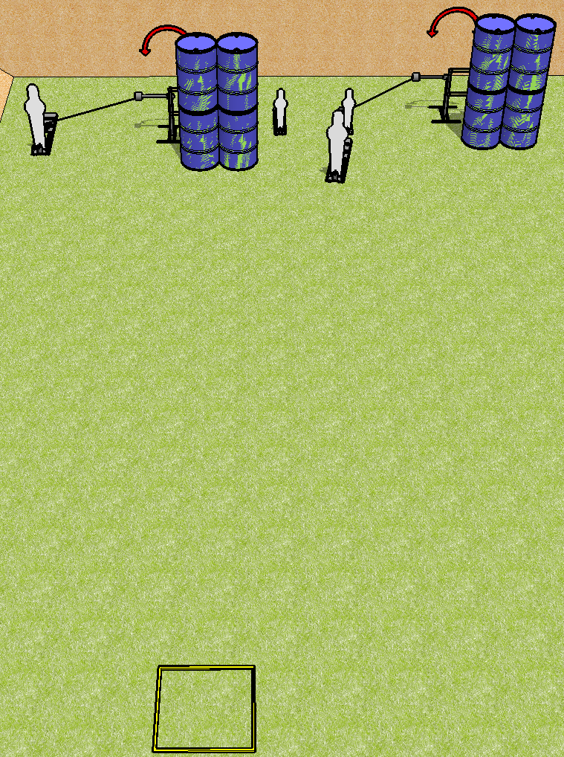
 | Dothan Practical Shooters – USPSA Match Heads or Tails Course Designer : Drew Coleman Bay: B1
Round Count 8 rounds 2 paper 2 pepper poppers, 2 mini poppers
Equipment List 2 swingers + activators Shooting box

Slide 2
Heads or Tails
Written Stage Briefing
Scoring: Comstock Rounds: 8
Targets: 2 IPSC, 4 steel
Handgun start position: inside shooting area, wrists below belt. Handgun is loaded and holstered.
PCC start position: Inside shooting area, stock on belt. Loaded carbine is held with both hands, safety on.
Stage Procedure: on the audible start signal, engage targets as they become available from within the shooting area. T1 is activated by P1, T2 is activated by P3, both remain visible at rest.

